Slide 1
Networking Basics – Day 1
Presented: Vigneshwar, Manibharathi

Slide 2
Agenda
Agenda
Happy Flow of Traffic
Why is Networking Important?
IP Address Basics
IP Address Example
Public Vs Private Ips
Classes of IPs & CIDR
Subnetting
Routers & Gateways
NAT
Network measurements/metrics
Tools
2

Slide 3
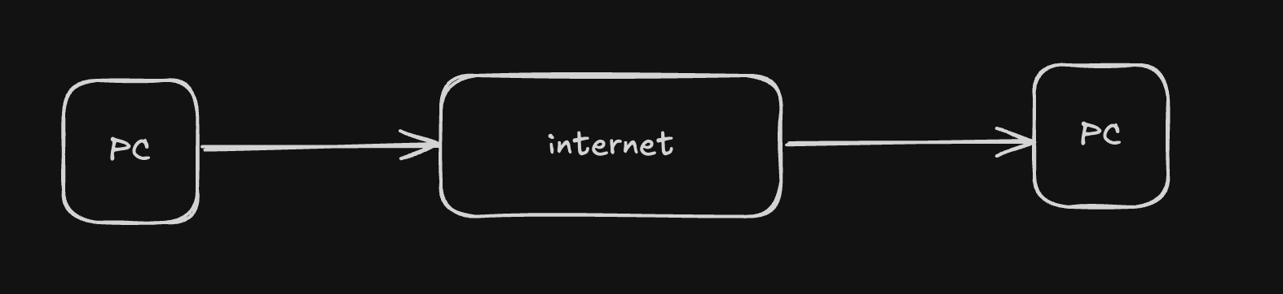
What is internet
"The Internet is the global system of interconnected computer networks that uses the Internet protocol suite (TCP/IP) to communicate between networks and devices." - wiki
The internet is basically a huge worldwide network that lets computers, phones, and other devices connect and exchange information with each other. Think of it as the infrastructure that makes websites, email, apps, and online services possible.
12
Notes:
Nithya

Slide 4
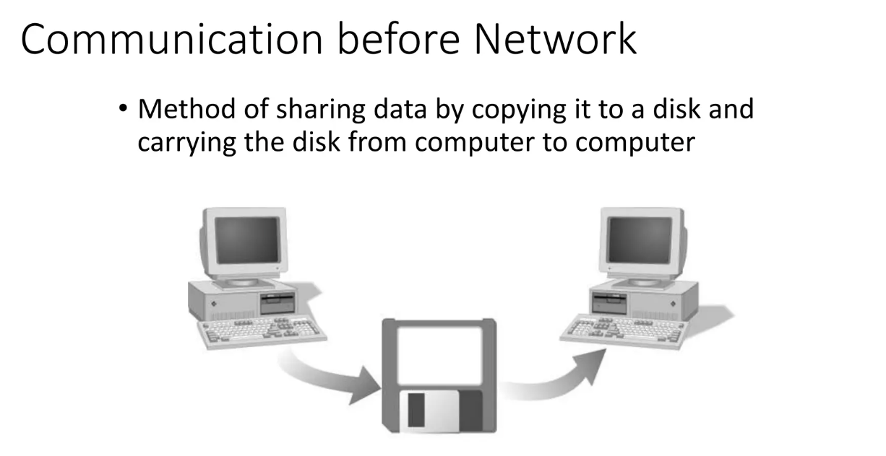
Importance of Networking
Networks are important because they let devices communicate and share resources instead of working in isolation. Without networks, every computer would be a standalone box with no way to exchange data, collaborate, or access centralized resources.
Practically:
They allow file, data, and application sharing.
They enable communication (email, chat, calls).
They connect businesses to customers and employees.
They provide access to the internet and cloud services.
12
Notes:
Nithya

Slide 5
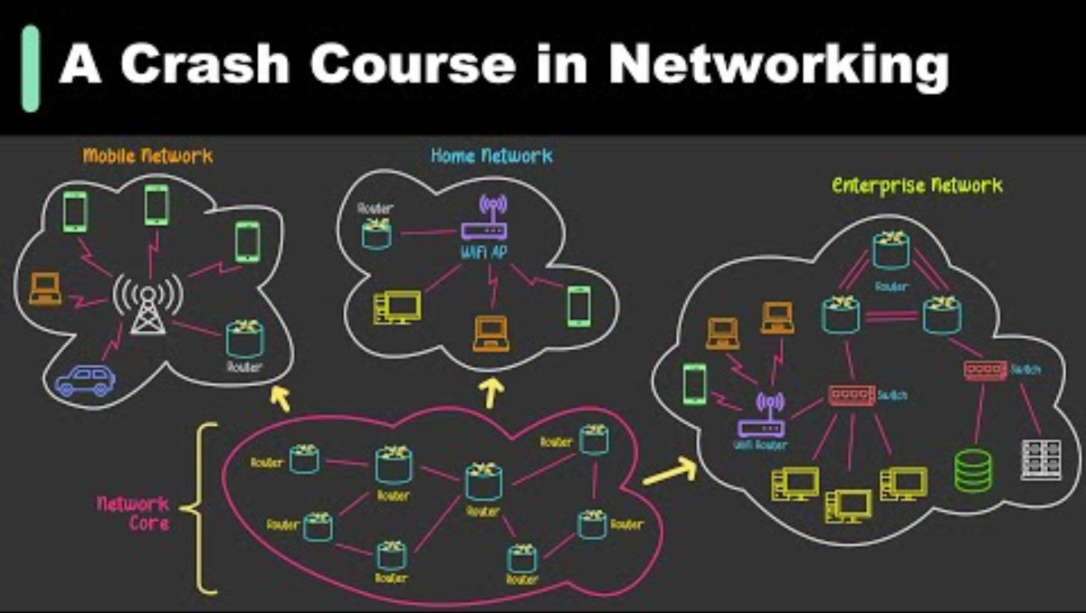
Happy Flow of the Traffic
Ensuring data packets travel efficiently from source to destination without delay or loss
Importance: A smooth traffic flow ensures * high performance * minimizes latency * maximizes network
Notes:
Nithya

Slide 6
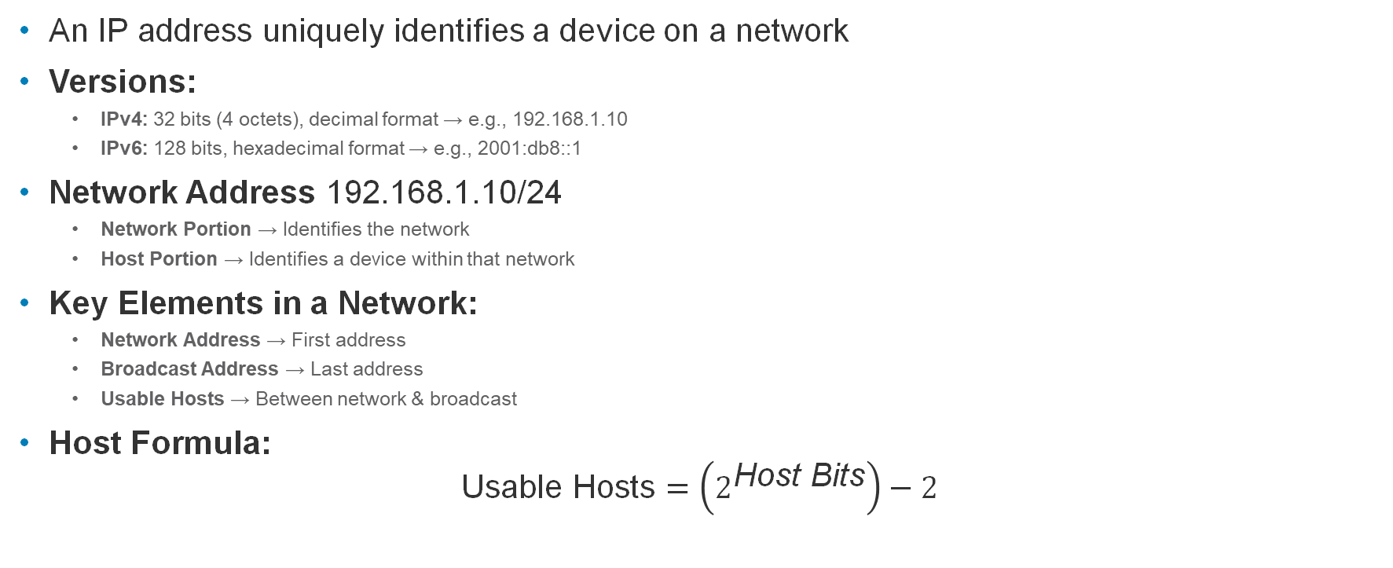
IP Address Basics
An IP address uniquely identifies a device on a network
Versions:
IPv4: 32 bits (4 octets), decimal format → e.g., 192.168.1.10
IPv6: 128 bits, hexadecimal format → e.g., 2001:db8::1
Network Address 192.168.1.10/24
Network Portion → Identifies the network
Host Portion → Identifies a device within that network
Key Elements in a Network:
Network Address → First address
Broadcast Address → Last address
Usable Hosts → Between network & broadcast
Host Formula:
$$\text{Usable} \text{Hosts}=\left(2^{\text{Host} \text{Bits}}\right)−2$$

Slide 7
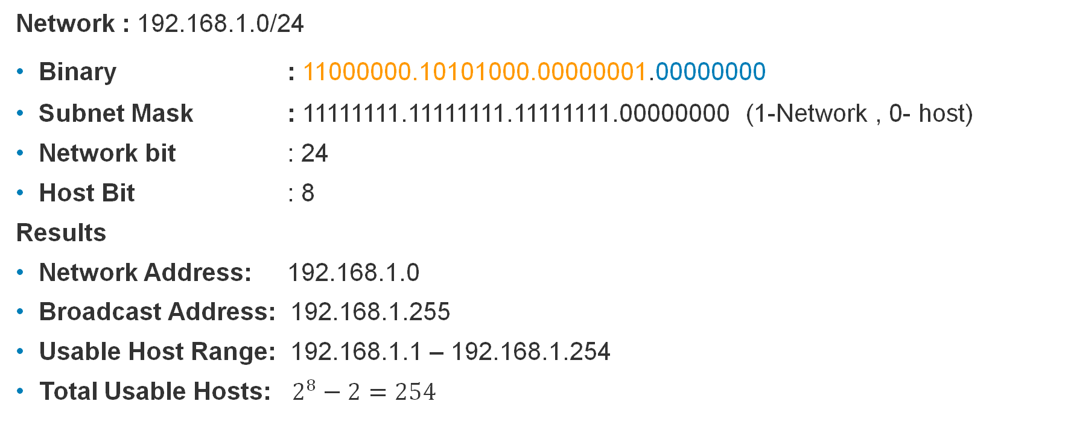
IPv4 Example
Network : 192.168.1.0/24
Binary : 11000000.10101000.00000001.00000000
Subnet Mask : 11111111.11111111.11111111.00000000 (1-Network , 0- host)
Network bit : 24
Host Bit : 8
Results
Network Address: 192.168.1.0
Broadcast Address: 192.168.1.255
Usable Host Range: 192.168.1.1 – 192.168.1.254
Total Usable Hosts: $2^{8}−2=254$

Slide 8
Public vs Private IPs
Public IPs
Unique, routable on the internet.
Example: Cloud servers, websites.
Private IPs
Internal use only, not internet-routable.
Defined by RFC 1918:
10.0.0.0/8
172.16.0.0/12
192.168.0.0/16
RFC 3927 → Link-local (169.254.0.0/16)
IETF , IANA, RIRs, IEEE, ISO, W3C

Slide 9
Classes of IPs & CIDR (cheatsheet)
Class A → 1–126, default mask /8 (large networks).
Class B → 128–191, default mask /16 (medium networks).
Class C → 192–223, default mask /24 (small networks).
Class D → 224–239 (multicast).
Class E → 240–255 (experimental).
Flexible way to define networks.
Format: IP/prefix-length (e.g., 192.168.1.0/24).
Prefix length = number of bits for network.
Example:
/24 → 256 total IPs (254 usable hosts).
/16 → 65,536 IPs.
/30 → 4 IPs (used in point-to-point links).

Slide 10
Subnetting
Breaking a big network into smaller ones.
Improves organization, performance, and security.
Example:
192.168.1.0/24 → split into 4 subnets of /26.
Each has 62 usable hosts.
Subnetting avoids IP wastage and isolates networks.

Slide 11
Routers & Gateways
Router = Connects multiple networks, forwards packets.
Gateway = The exit point to another network.
Example:
PC → Router (192.168.1.1) → ISP → Internet.
Without a gateway, devices can only talk inside their subnet.

Slide 12
NAT (Network Address Translation)
Private IPs cannot go directly to internet.
NAT translates private → public IP.
PAT (Port Address Translation):
Many private devices share one public IP.
Example:
Laptop (192.168.1.10) + Phone (192.168.1.20) → NAT → Public IP (203.x.x.x).

Slide 13
Tools
Ping
Traceroute / tracert (Windows)
MTR (My Traceroute)
nslookup / dig
telnet / nc (netcat)
arp / arp -a
ipconfig (Windows) / ifconfig / ip (Linux)
netstat
tcpdump
Wireshark
curl / wget
nmap
ip

Slide 14
Network measurements/metrics
Bandwidth
Throughput
Latency
Propagation delay
Packet loss
Jitter
Encrypted vs. unencrypted traffic
Packet drops
Intrusion attempts detected

Slide 15
Q&A

Slide 16
Tasks

Slide 17
Thank You

